Slide 1



National Water & Sanitation Master Plan “A call to action”
MINISTER’S INTERACTIVE SESSION WITH WATER SERVICES AUTHORITIES (WSA’s)
27 September 2018
Presented by: Trevor Balzer
DDG: Strategic and Emergency Projects
PRESENTATION TITLE
Presented by:
Name Surname
Directorate
Date

Slide 2

OBJECTIVE OF NW&SMP
The Master Plan points out the priority actions required until 2030 and beyond to ensure the water security and equitable access to water and sanitation services for all in RSA.
It was developed in partnership with all relevant organs of state and water sector stakeholders, to give effect to local, national, regional, continental and international water and sanitation delivery targets and commitments.
Ensure integrated planning and development across the entire water value chain (support the recommendations from Cabinet Lekgotla on IMTT Basic Services Strategy: eg. Focus on misalignment where bulk infrastructure has been provided without provision made for reticulation, LR4).

Slide 3
OBJECTIVE OF NW&SMP (2)
Supports the President’s Economic Stimulus and Recovery Plan (ESRP) and give priority to the ‘Four broad parts’ :
  Implementation of growth enhancing economic reforms;
  Reprioritisation of public spending to support job creation;
  Establishment of an Infrastructure Fund.
  Addressing urgent and pressing matters in education and health.
  Investing in municipal social infrastructure improvement.
Notes:
The central element of the economic stimulus and recovery plan is the reprioritisation of spending towards activities that have the greatest impact on economic growth, domestic demand and job creation, with a particular emphasis on township and rural economies, women and youth.
Our government has limited fiscal space to increase spending or borrowing, it is imperative that we make sure that the resources that we do have are used to the greatest effect.
Re-prioritised funding will be directed towards investments in agriculture and economic activity in townships and rural areas.
Prioritised the revitalisation of three regional and 26 township industrial parks as catalysts for broader economic and industrial development in townships and rural areas.
With a view to unlocking the potential to create more jobs on a large scale we have decided to set up a South Africa Infrastructure Fund, which will fundamentally transform our approach to the roll-out, building and implementation of infrastructure projects.
The private sector will be invited to enter into meaningful partnerships with government in this fund.
The dedicated Infrastructure Execution Team in the Presidency will identify and quantify ‘shovel ready’ public sector projects, such as roads and dams, and engage the private sector to manage delivery.
As part of the reprioritisation of spending, additional infrastructure funding will be directed towards provincial and national roads, human settlements, water infrastructure, schools, student accommodation and public transport.
We have identified 57 priority pilot municipalities in order to unlock infrastructure spending in the short term.
This spending will cover, among other things, sewerage purification and reticulation, refuse sites, electricity reticulation and water reservoirs.

Slide 4
Context (Constitution and NWA)
The Constitution contains several provisions that give direction to the water and sanitation sector
Constitutional imperative:
  Guarantees the right to an environment that is not harmful to health or well-being (Section 24(b)(i to iii));
  Guarantees the right to have access to sufficient food and water (Section 27(1)(b))
  States that the property clause may not impede the state from taking measures to achieve land, water and related reform, in order to redress the results of past racial discrimination (Section 25(8))
Notes:
……………. and to have the environment protected, for the benefit of present and future generations, through reasonable legislative and other measures that prevent pollution and ecological degradation; (ii) promote conservation; and (iii) secure ecologically sustainable development and use of natural resources while promoting justifiable economic and social development
This is an opportunity to remind delegates that the NWA and the Constitution only have 2 rights-based users and that DWS is tightening its focus to concentrate on its 2 primary responsibilities, namely making sure basic provision happens and looking after the resource. It’s an opportunity to set the record straight if there may be some misunderstanding regarding the fact that beyond the two rights-based uses, all others are entitled users (therefore not guaranteed) – and especially so in a constrained environment such as the one the country is in at present….

Slide 5
Context (Constitution and NWA)
The National Water Act (NWA) seeks to ensure that water resources are protected, used, developed, conserved, managed, and controlled to take into account:
  To promote equitable access;
  Redress the results of past racial and gender discrimination.
The National Water Act translates this Constitutional imperative into (the NWA version of “set aside”):
  The Basic Human Needs Reserve is the water allocated for human consumption before any other water can be assigned (The Reserves ensures that people are never overlooked in favour of ecosystems, calculated as a minimum of 25 litres per person per day).
  The Ecological Reserve relates to water required to protect and sustain the aquatic ecosystems in order to secure ecologically sustainable development and water use (the National Water Act protects the rights of water ecosystems because they provide people with many free services necessary to life).
Notes:
……………. and to have the environment protected, for the benefit of present and future generations, through reasonable legislative and other measures that prevent pollution and ecological degradation; (ii) promote conservation; and (iii) secure ecologically sustainable development and use of natural resources while promoting justifiable economic and social development;
While the restitution of agricultural land has been slower than intended, the reallocation of water has not always kept pace with the transfer of that land. In some instances, the previous owners traded away their existing lawful water use rights, so that the water allocation was not transferred to land reform beneficiaries.
This is an opportunity to remind delegates that the NWA and the Constitution only have 2 rights-based users and that DWS is tightening its focus to concentrate on its 2 primary responsibilities, namely making sure basic provision happens and looking after the resource. It’s an opportunity to set the record straight if there may be some misunderstanding regarding the fact that beyond the two rights-based uses, all others are entitled users (therefore not guaranteed) – and especially so in a constrained environment such as the one the country is in at present….

Slide 6
Content of NW&SMP
The National Water and Sanitation Master Plan ( NW&SMP) is a “Call to Action”. It seeks to rally all Water Sector Stakeholders in South Africa to work together to address the challenges confronting the Water and Sanitation Sector
The Plan enable the achievement of the targets set out in the National Development Plan (NDP) Vision for 2030 and the Sustainable Development Goals (SDG Goal 6 2030), of affordable and reliable access to sufficient and safe water and hygienic sanitation for socio-economic growth and well-being, with due regard to the environment
The Plan is also geared for the 5 key Strategic Pillars of the Department.
- Pillar 1 National Water Resources and Services Authority
- Pillar 2 National Water Resources and Services Regulator
- Pillar 3 Water Resources and Services Value Chain
- Pillar 4 Water Resources and Services Master Plan
- Pillar 5 Institutional Rationalisation and Organisational Alignment
Notes:
……………. and to have the environment protected, for the benefit of present and future generations, through reasonable legislative and other measures that prevent pollution and ecological degradation; (ii) promote conservation; and (iii) secure ecologically sustainable development and use of natural resources while promoting justifiable economic and social development
This is an opportunity to remind delegates that the NWA and the Constitution only have 2 rights-based users and that DWS is tightening its focus to concentrate on its 2 primary responsibilities, namely making sure basic provision happens and looking after the resource. It’s an opportunity to set the record straight if there may be some misunderstanding regarding the fact that beyond the two rights-based uses, all others are entitled users (therefore not guaranteed) – and especially so in a constrained environment such as the one the country is in at present….
NW&SMP: The Master Plan points out the priority actions required until 2030 to ensure the water security and equitable access to water and sanitation services for all in RSA. It was developed in partnership with all relevant organs of state and water sector stakeholders, to give effect to local, national, regional, continental and international water and sanitation delivery targets and commitments.

Slide 7
5 Key Strategic Transformation Pillars
Pillar 1
National Water Resources and Services Authority:
Task team established
Draft Concept note Developed
Pillar 2
National Water Resources and Services Regulator :
Draft business case to be revised
Pillar 3
Water Resources and Services Value Chain
Pillar 4
A Water Resources and Services Master Plan
Approved by Cabinet.
Pillar 5
Institutional Rationalisation and Organisational Alignment
Progress :
7 CMAs will be established
Irrigation Boards transformed

Slide 8
Outline of philosophy
The Plan is based on five key objectives that define a ‘new normal’ for water and sanitation management in South Africa:
  Resilient and fit-for-use water supply
  Universal water and sanitation provision
  Equitable sharing and allocation of water resources
  Effective infrastructure management, operation and maintenance and
  Reduction in future water demand.
The Plan is configured based on twelve milestone elements, which define the key programmes identified as necessary to operationalise the new water and sanitation sector paradigm. Six of these elements fall under the heading of water and sanitation management, and the other six under the heading of enabling environment, shown in diagram on previous slide.

Slide 9
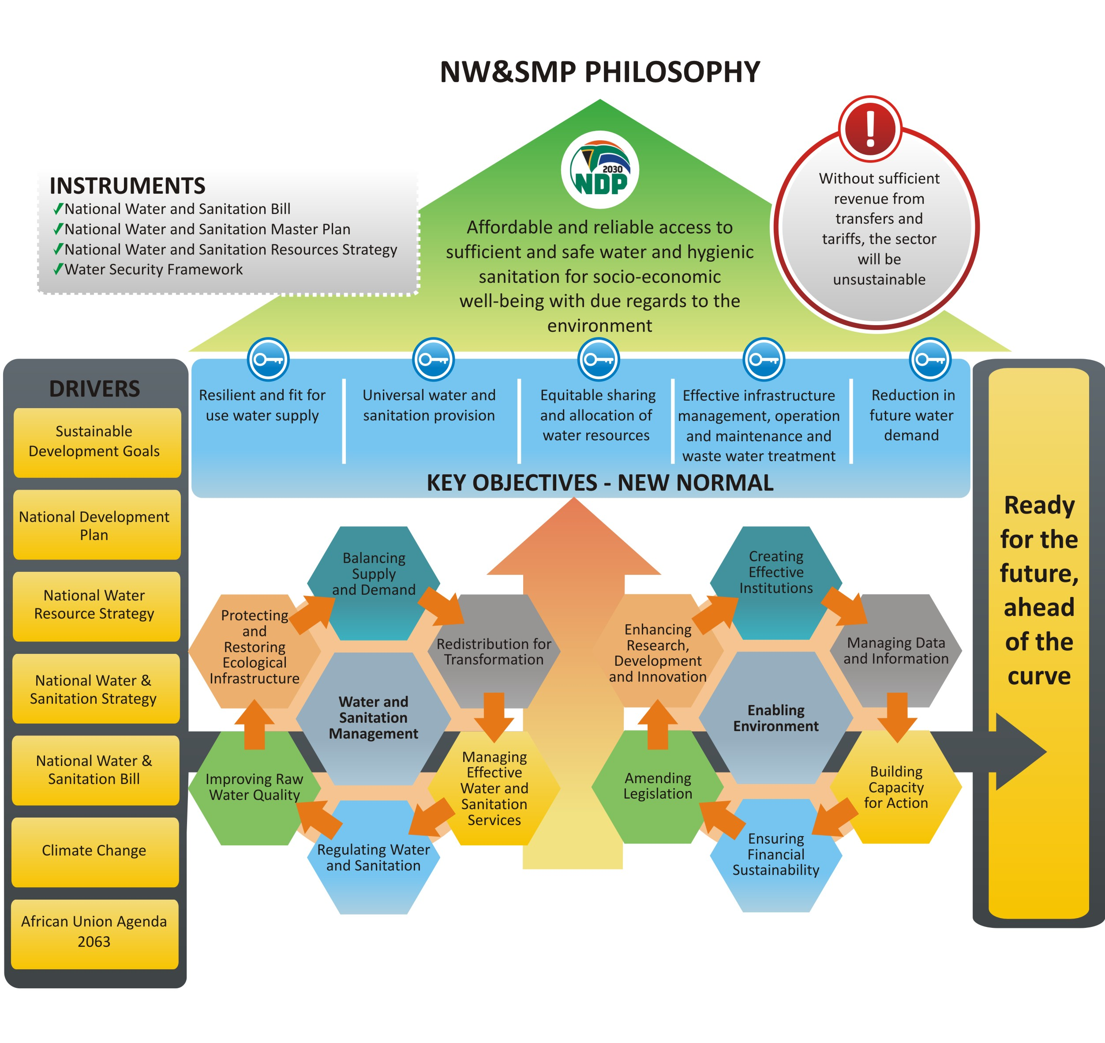
Consolidate and Prioritise Schedule of Actions
Notes:
Trevor – we will make slight corrections and additions to this slide before Friday – I want to add the UN HLP to the Drivers, and Barbie has some additions to the finance alert. . This slide provides the presenter with the opportunity to point out that the structure of the parthenon has been tweaked, with the honeycombs now incorporated.

Slide 10
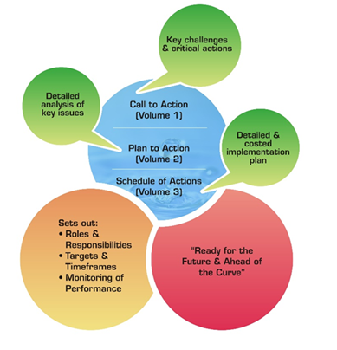
Structure of NW&SMP
 | Volume 1: Call to Action briefly outlines the milestone challenges and the recommended actions Volume 2: Plan to Action provides detailed account and analysis of the rationale for challenges and actions, and addresses future inter-governmental collaboration, M&E protocols and continuous stakeholder engagement during implementation. Volume 3: Schedule of Actions provides a detailed consolidated and prioritised implementation plan with costs covering all the actions required across the sector to achieve the objectives of the plan.

Slide 11
Interaction of twelve elements
Reducing Demand and Increasing Supply
Creating Effective Institutions
Protecting and Restoring Ecological Infrastructure
Redistribution for Transformation
Enhancing Research, Development and Innovation
Managing Data and Information
Water and Sanitation Management
Enabling Environment
Improving Raw Water Quality
Managing Effective Water Services and Sanitation
Amending Legislation
Building Capacity for Action
Regulating Water and Sanitation
Ensuring Financial Sustainability

Slide 12
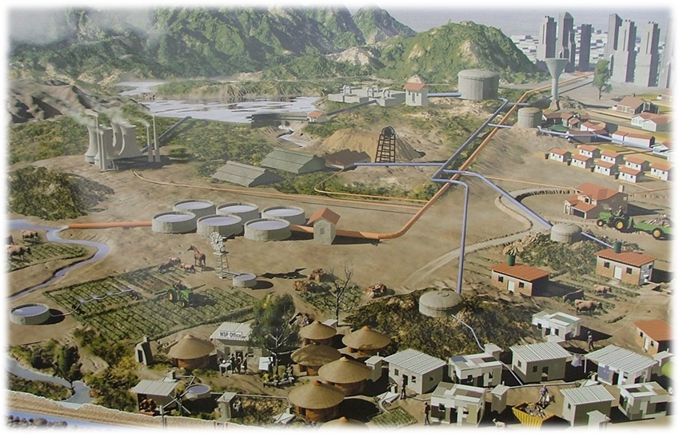
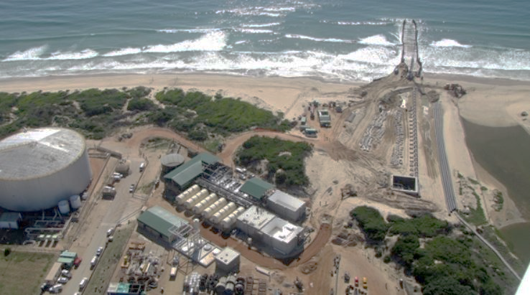
Purification
Distribution
Commercial
Users
Rainfall
Water Resources –
Raw Water
Storage in Dams
Catchment
Management Agency
Water
Resource
Management
Charge
Bulk Water
Services Provider
Bulk Potable
Water
Tariff
Department of Water and Sanitation
Raw
Water
Tariff
Industry
Abstraction
Reticulation
Water Services
Authority
Municipal
Water
Tariff
Mining
Water Services
Provider
Treatment and
Discharge
Waste Collection
Water Services
Provider
Water Services
Provider
Municipal
Sanitation
Tariff
Agriculture
Water Resources –
Groundwater
Domestic
Reticulation
Water Resources –
Raw Water
Abstraction
Water Services
Provider
Catchment Management
Agency
Water Services
Provider
Water Resources –
Desalination
Water Services
Provider

Slide 13
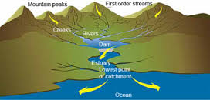


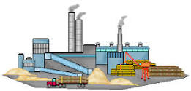
Water Business
Resource development
DWS
Catchment Management Agency
Water user Association
Distribution infrastructure
Water Service Authorities
1
2
Bulk infrastructure:
Water Boards
Connector infrastructure
Internal infrastructure
Catchment
Pumping station
Distribution reservoir
Bulk water pipeline
Connector pipeline
3
To other settlements
Dam
Water treatment works
To industry
Internal pipeline
network
River
4
Collector sewer
Wastewater treatment works
Outfall sewer
5
Sewerage pump station
Sewerage reservoir
Treated effluent outfall
Assimilative capacity of receiving water body
Impacts on aquatic environment and downstream water users

Slide 14
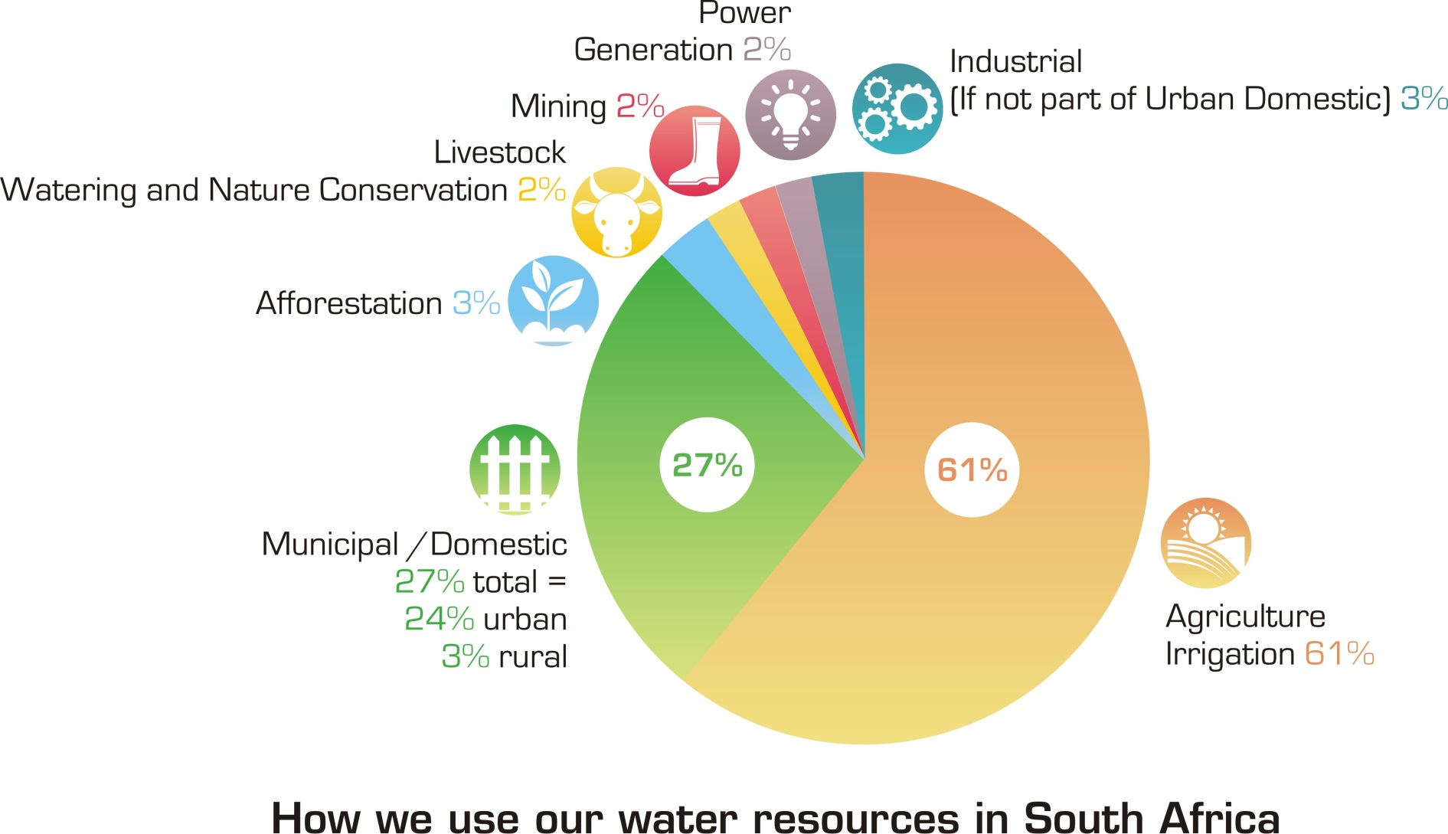
Current water use by sector

Slide 15
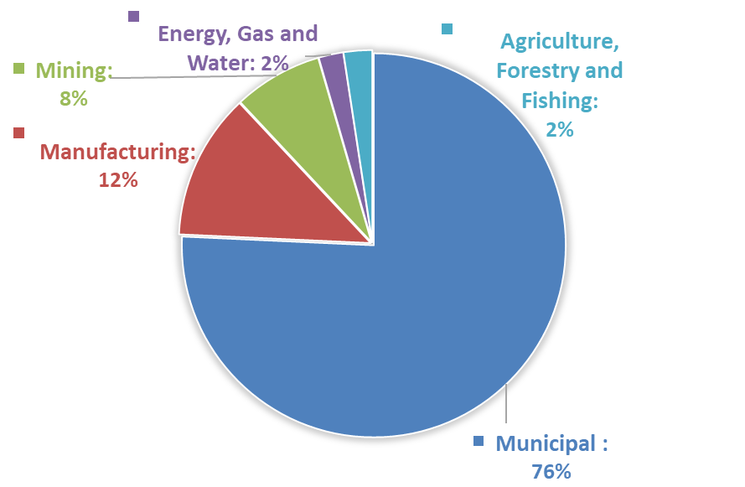
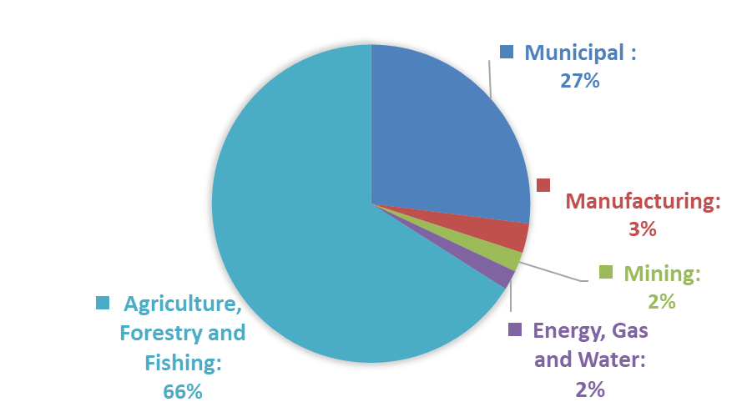
GDP Contribution per Sector versus
Water Use per Sector
GDP Contribution (Stats SA PO441)
Water Use (DWS Water & San Master Plan)
Note that the level of assurance at which agricultural water is supplied is lower than that of other sectors.

Slide 16
Problem statement/Key challenges (1)
The master plan highlights the key challenges in the water sector . In this presentation the focus is only on those key challenges relevant to CoGTA
Over 3 million people still do not have access to a basic water supply service and 14.1 million people do not have access to safe sanitation.
Past 20 years, the sector has failed to deliver fully on its mandate for water allocation reform (reallocation to address racial and gender discrimination).
Some 77% of rural households are indigent and therefore entitled to free basic water which is placing a significant strain on municipalities with a low revenue base.
Municipalities have made little progress towards meeting water conservation targets set by the NDP with average municipal water use currently around 237 litres per person per day compared to the world average of 173 litres per person per day.
Notes:
While the restitution of agricultural land has been slower than intended, the reallocation of water has not always kept pace with the transfer of that land. In some instances, the previous owners traded away their existing lawful water use rights, so that the water allocation was not transferred to land reform beneficiaries.

Slide 17
Problem statement/Key challenges (2)
Responsibility for water supply and sanitation (constitutionally) lies with 144 municipalities that are Water Services Authorities (WSAs). At least a third of these are regarded as dysfunctional and more than 50% have no, or very limited, technical staff. Twenty-seven priority districts have been identified as being particularly dysfunctional and requiring specific intervention (though not all are WSAs).
The reliability of services that have been provided since the advent of democracy is declining, with only 64 % of households having access to a reliable water supply service (StatsSA General Household Survey).
The institutional landscape of the water sector is also overly complex and not sufficiently transformed, which is impacting the value chain.

Slide 18
Governance of water and sanitation
Constitution
Section 139(1)
CONSTITUTION
Water Resource Management
(incl. regulation of water services)
PFMA
Premier of Province
President
MFMA
Municipal structures Act
Municipal Systems Act
Constitution
Section 139(7)
Minister:
Water & Sanitation
Sanitation Services
Executive Mayor
of WSA (144)
Water Research Act
National Water Act
Water and
WRC
Notice of
establishment
CMAs (9)
Water Service Provider
[Internal]
Water Services Act
All not delegated
TCTA
Water Service Provider
[External]
Water supply agreement
Water Boards (6)
DWS
IA
Legend
IA
Legislated
Water supply agreement
Internal arrangement
(Implementing Agent)
Water supply agreement
External Service Provider
Water User Assoc. / Irrigation Board
Water Supply Agreement
Midvaal / Lebalelo
Other small users
Notes:
139. Provincial intervention in local government-(1) When a municipality cannot or does not fulfill an executive obligation in terms of the Constitution or legislation, the relevant provincial executive may intervene by taking any appropriate steps to ensure fulfillment of that obligation
139. (7) If a provincial executive cannot or does not or does not adequately exercise the powers or perform the functions referred to in subsection (4) or (5), the national executive must intervene in terms of subsection (I)or ( 5 ) in the stead of the relevant provincial executive.

Slide 19
Delivery trends (Stats SA)
Access to Piped Water above Target
Access to RDP on Target
MDG 2015
90 % Reliable Services 2019:
To be achieved through the following key focus areas:
New Infrastructure
Water Security
Functionality
Governance
Financial Modelling
MDG target met in 2015
Deteriorating infrastructure result in decline

Slide 20
Problem statement/Key challenges (3)
Current pricing strategy does not adequately make provision to: reward users who conserve water and penalise consumers that ignore consumption caps.
The water sector is not financially sustainable and the pricing strategy will have to be reviewed to address the historic undervaluation of water and sanitation services.
Waterborne sanitation is unsustainable, need to adopt “water-less” sanitation technology. Pragmatic management of the Free Basic Water policy is required.
Non-Revenue Water in municipalities is estimated at 41%, losing some R9.9 billion of potential revenue per year. The best performing municipalities achieve on average 25% and for practical reason it is not possible to achieve 0%. Need to deal with non-payment for services, and enforce cost-recovery.
High levels of debt at municipal level reverberate up the value chain, impacting on the financial sustainability.
South Africa invests R 42 billion per year into water infrastructure, and R13 billion into sanitation. The estimated capital investment requirement is R90 billion per year over the next ten years, which is R 33 billion per annum more than the current investment.

Slide 21
Proposed Solutions (1a)
  Improve governance of the Water and Sanitation sector (Enforcing policy, norms and standards and linkages to functionality)
  Apply “professional” business rules and principles Address Improved leadership and drive
  Stronger oversight
  Improved coordination
  Effective programme governance
  Outcome focused
  Macro master plan
  Inspire/movement
  Review accountability and responsibility and introduce more stringent requirements to WSA officials

Slide 22
Proposed Solutions (1b)
  Develop norms and standards regarding water services provision throughout the value chain regarding water service provision (technical, financial, skill requirement)
  DWS will establish a specialised municipal intervention unit for water and sanitation (MIUWS) to drive the national programme of interventions, which includes the reintroduction of a sector-wide approach (SWAP)
  DWS will form part of Joint team to work on all areas in which improved bulk and reticulation infrastructure alignment - including the seven pilot Water Services Authorities. (LR3)
  Implement a Municipal Upgrade Support Team to enable complete turnaround

Slide 23
Proposed Solutions (2)
  DWS will form part of the Co-ordinated Inter-Departmental and Inter-Governmental approach to planning, budgeting and implementation for Social Infrastructure and Services in the 57 Identified Prioritised Municipalities (LR1, ESRP)
  Address institutional arrangements regarding water and sanitation provision
  Review existing organizational structure and job responsibility models within WSA
  Review institutional arrangements with regards to WSA (include funding and equitable share)
  Improve skills in water and sanitation services
  Develop Implementation plan/strategy for capacity building within WSA per province

Slide 24
Proposed Solutions (3)
  Focus on accountability, ownership and commitment (MuSSA)
  Stronger regulation
  Discipline
  Hands-on management
  Performance obligations
  Address corruption
  Address poor financial management
  Appropriate appointments

Slide 25
Proposed Solutions (4)
  Focus on addressing “reliable” services (ESRP):
  Water supply is a non-stop-never-ending business – not a once of project delivery action
  Present focus only on infrastructure delivery – all existing programmes to be refocussed towards reliable service delivery
  Enforce application of lifecycle, asset management and business principles
  Behavioural change (stop water wastages, protect infrastructure and adapt to the full water mix)
  Address viability and affordability
  Address water security
  The Co-ordinated Service Delivery approach in the 57 Identified Priority Municipalities (8 Metros, 43 Locals and 6 Districts) must reach the greatest number of households still requiring basic services: (LR2, ESRP) (eg WCWDM)

Slide 26
Proposed Solutions (5)
  Institutional effectiveness
  DWS support LR 6 : Back-to-Basics Programme
  DWS developed a Municipal Strategic Self-assessment( MuSSA) to determined the overall business health for WSA’s by identifying key municipal vulnerabilities across a range of business attributes
  Implement the MPAPs that is the result of the MuSSA programme
    MuSSA assesses 18 key business health attributes
    From the identified municipal shortcomings, the DWS has developed 21 Municipal Priority Action Plans (MPAPs) for selected municipalities.
    The set of actions for each municipality to mitigate to the agreed MuSSA vulnerabilities is aligned to its 5 year Master Plans, WSDPs and IDPs.

Slide 27
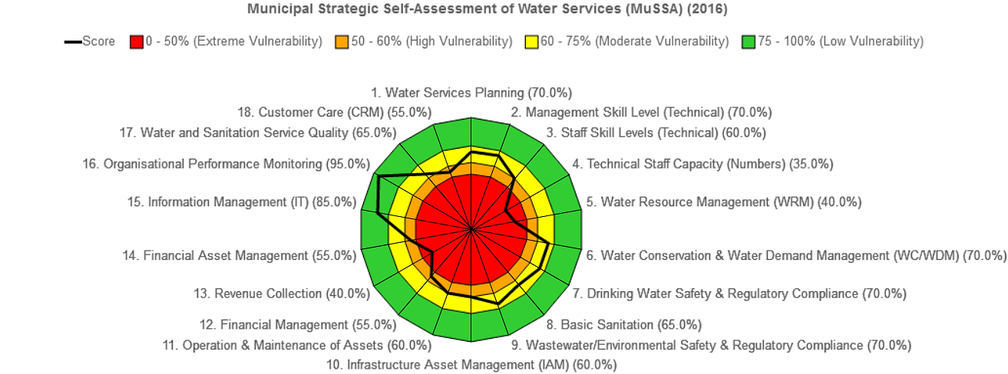
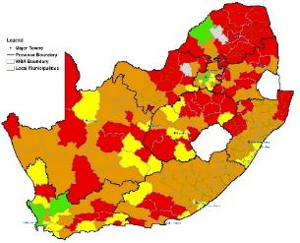
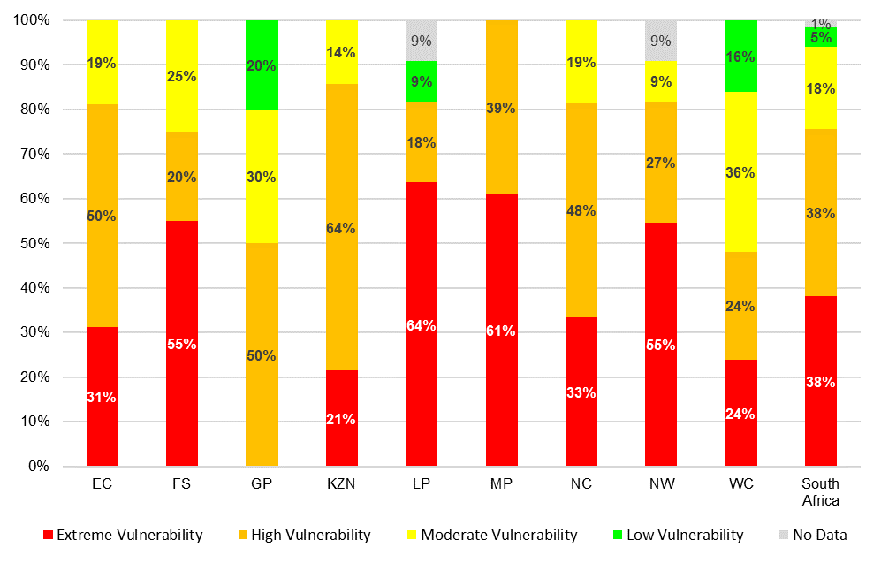
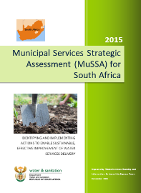
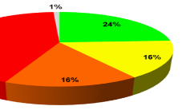
MuSSA output indicates “business health / vulnerability” for each business attribute for a WSA
Also provides a “rolled-up” overall Vulnerability Index for each WSA

Slide 28

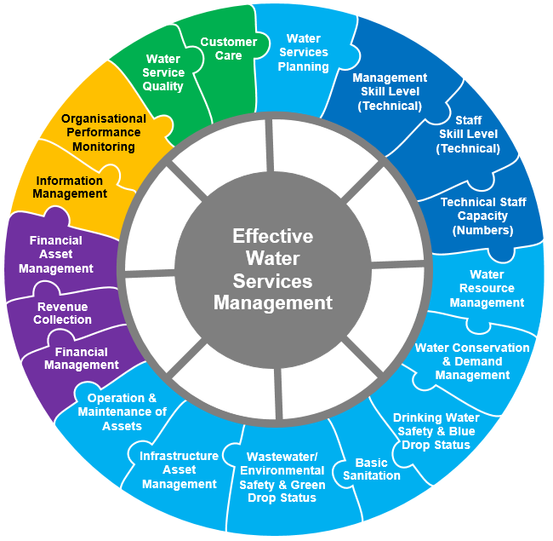
MuSSA/B2B Business Attributes
MUSSA
Municipal Strategic Self Assessment
Putting People First
Service Delivery
Good Governance
Sound Financial Management
Building Capable Local Government Institutions

Slide 29
Proposed Solutions (6)
  Eliminate water and sanitation service backlogs due to functionality problems
  Establish on-going capacity to assist WSA with technical guidance /investigation on emergency water services situations particularly for WTW and WWTW
  Develop Water conservation and demand management plans for each WSA (must eventually form part of the infrastructure master plan)
  Develop O & M / asset management related regulations and enforce
  Eliminate water and sanitation infrastructure backlogs
  Review and re-prioritise the current capital implementation funding for each WSA in line with the backlog
  Alignment of the governance of the RBIG / MIG programmes as well as other programme (both National and provincial)
  Develop provincial bulk master plans integrating Water resource planning, WSA planning and bulk planning
  Stop misalignment (LR4)
  Focus on misalignment where bulk infrastructure has been provided without provision made for reticulation

Slide 30
Proposed Solutions (7)
  Improve monitoring, reporting and evaluation
  Resuscitate the Intergovernmental Forums to discuss and make recommendations on infrastructure and service delivery issues (Basic services Task Team, MIT3 and etc.)
  Analysis of current funding ( What is collected, grants available)
  Provide a report analysing grants that are flowing to each of the municipalities as well as other revenue sources following to the municipality. Report to indicate how are the funds being used
  DWS support LR 5: Financial Management

Slide 31
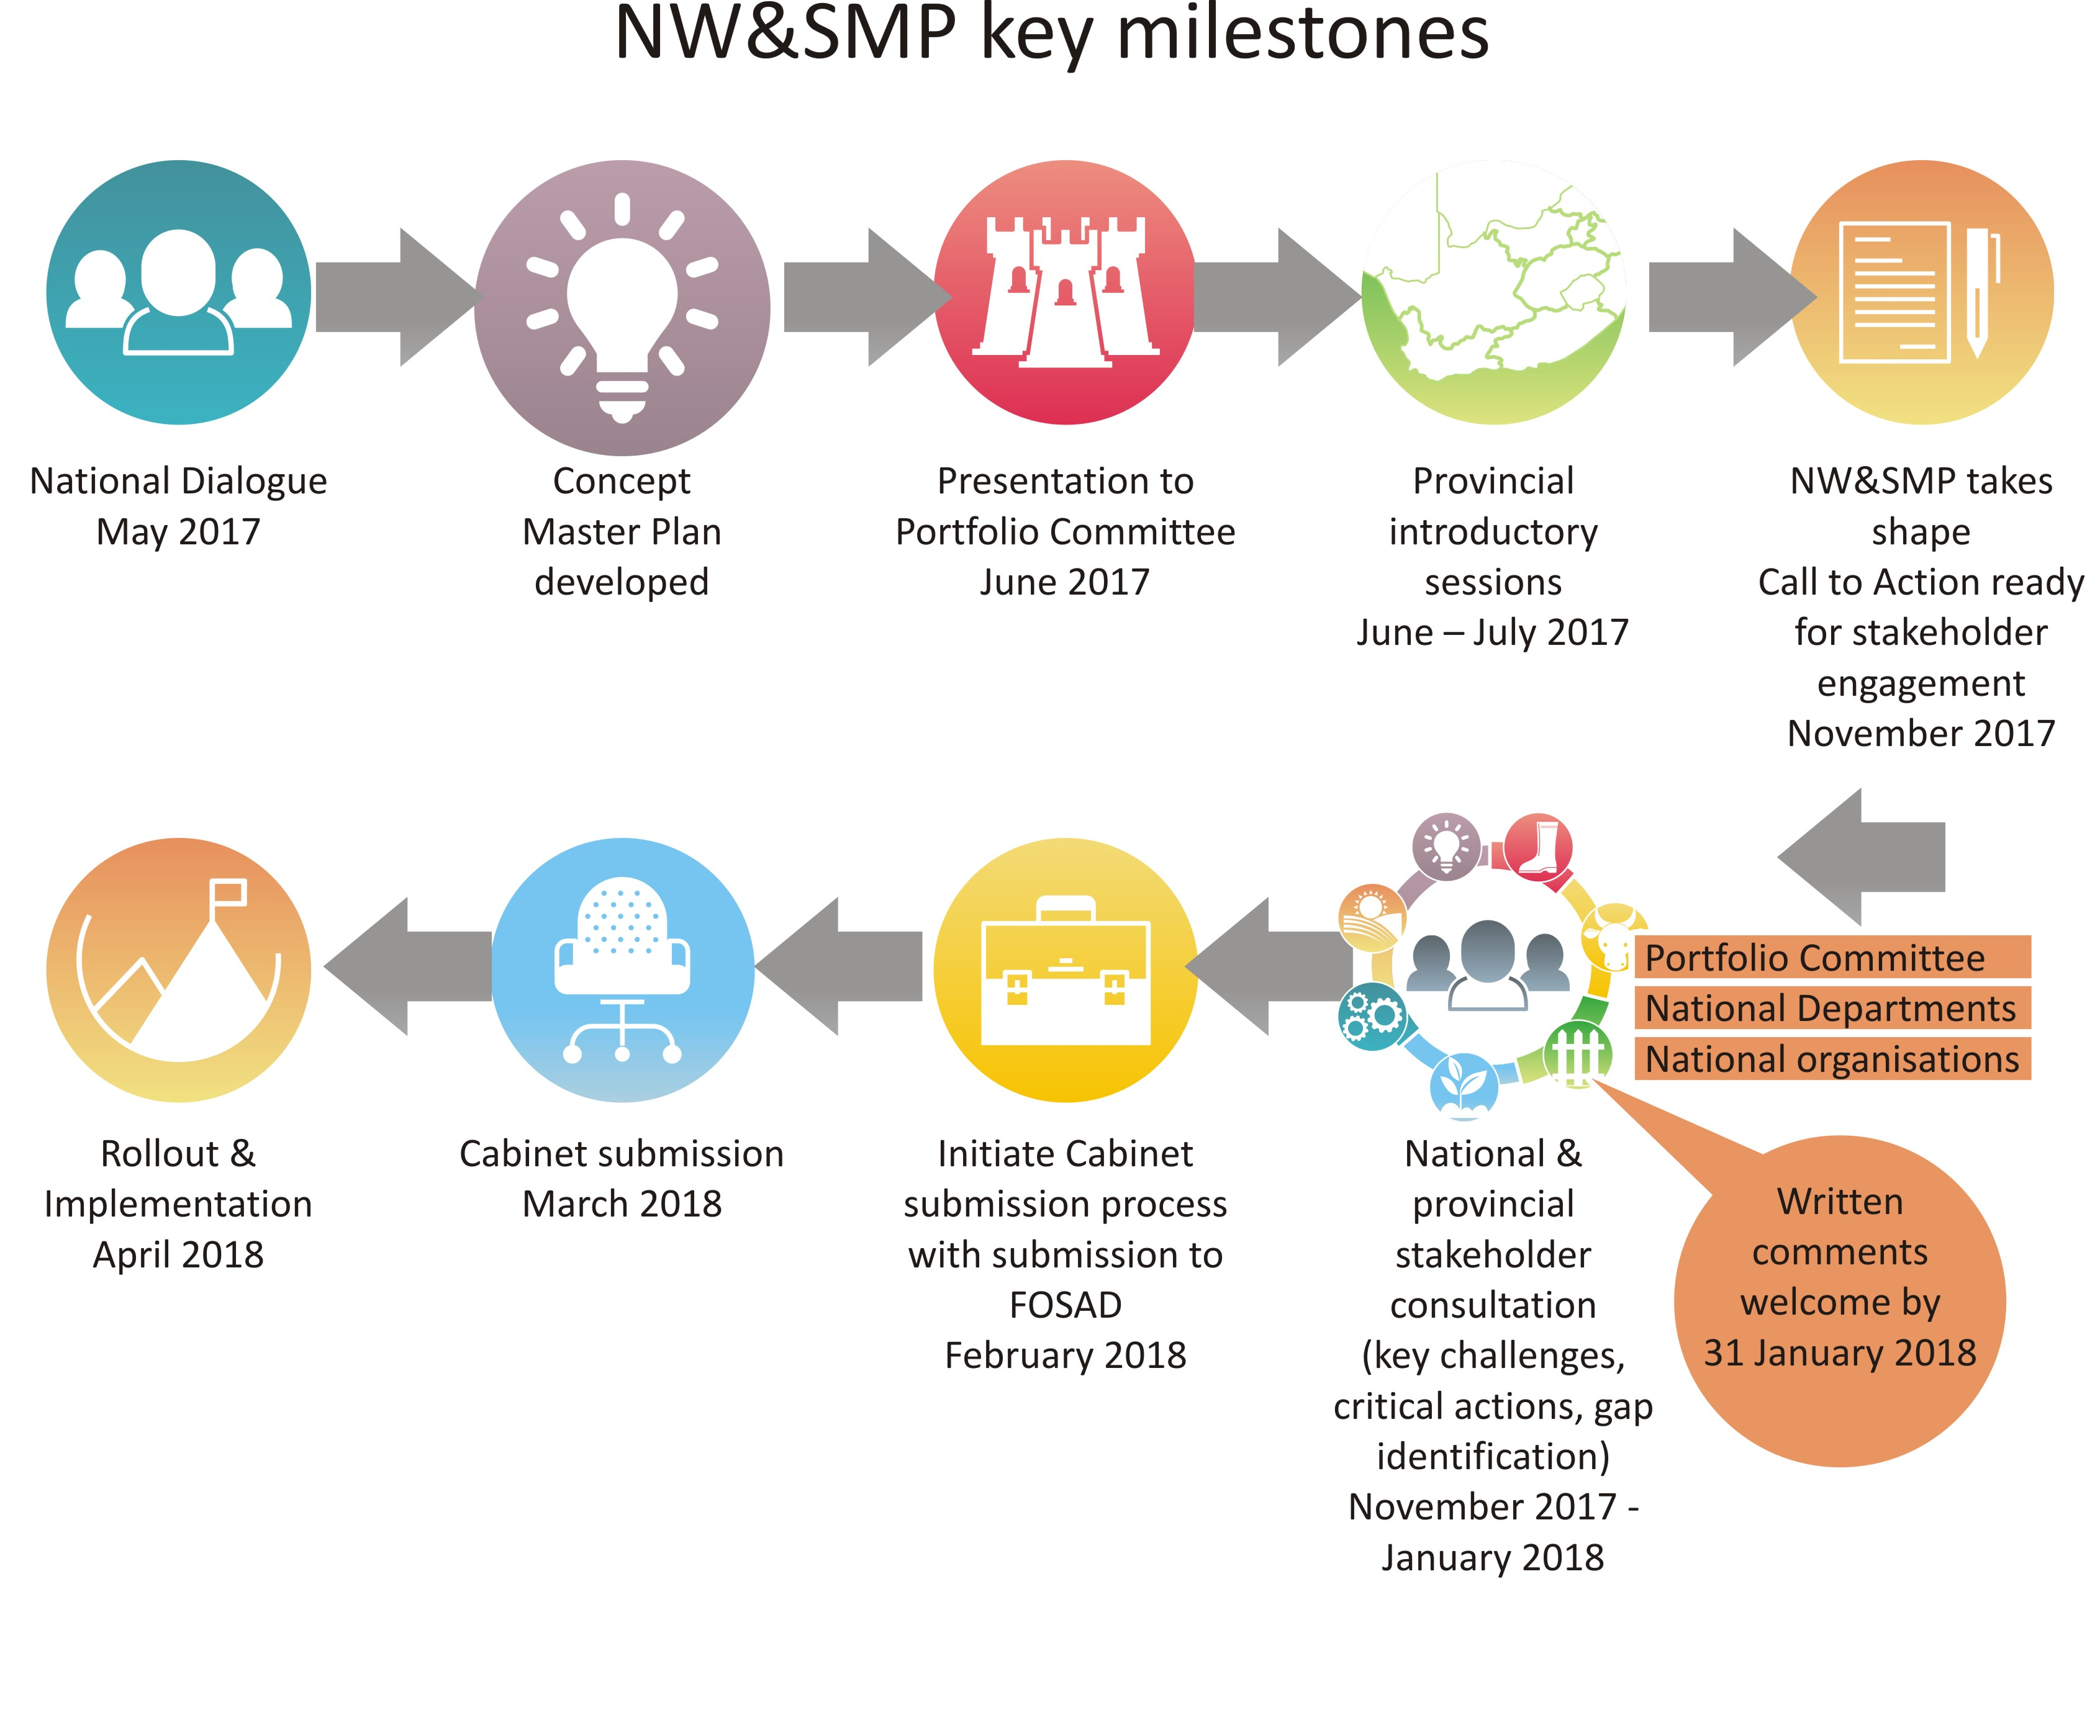
Road Map
Provincial Introductory sessions: Round 1 June-July 2017
Operation Phakisa- (4th Quarter 2018/19)
Roll out of implementation (April 2019 onwards)
Presentation to Cabinet Committee -27 June 2018
Portfolio Committee – 29 August 2018
Presented to FOSAD :
SPCHD-14 Mar 2018
ESEID- 12 Apr 2018
Submission to Minister-March 2018

Slide 32
Phakisa
On 27 June 2018 the Cabinet Committee of the Government of the RSA noted the development of the first National Water and Sanitation Master Plan
Cabinet also supported a recommendation that the sector undertake a collaborative, embedded planning initiative utilising the Phakisa methodology adopted by Government in 2013.
The support of Cabinet for the mobilisation of a Phakisa for Water and Sanitation is a game-changer for the DWS and the broader water sector.
The sector is set to join a vanguard group of sectors in the South African economy as it adopts this planning methodology.
The Phakisa on Water and Sanitation will see sector partners agree the concrete actions, budgets and timeframes necessary to implement the Master Plan and ensure a water-secure future for the country, while also addressing the triple challenge confronting the country, namely poverty, unemployment and inequality.
It is the intention of the Department to mobilise the sector to undertake the Phakisa by March 2019. A planning period of 4 – 6 weeks is anticipated.

Slide 33
THANK YOU

